Slide 1
Malignant Comment Classifier
Submitted by :- Ruchi Tiwari

Slide 2
Data Preparation
With the help of Pandas Library We will upload our data to Jupyter Notebook.
Once our data is uploaded with the help of predefined method (i.e. read_csv) we can read data for further processing.

Slide 3
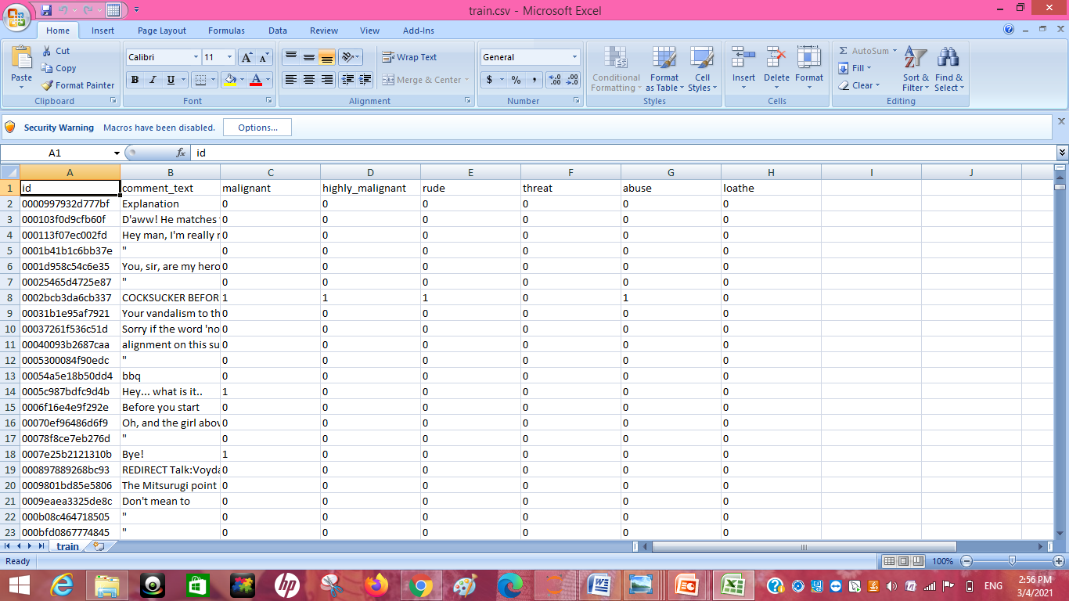
Train File in CSV format

Slide 4
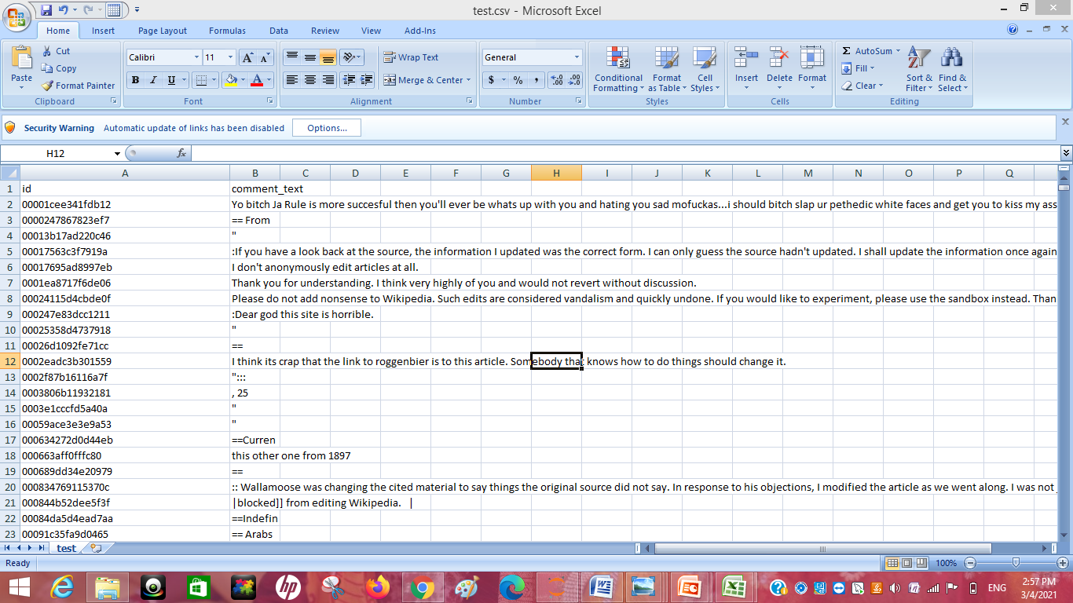
Test file in CSV format

Slide 5
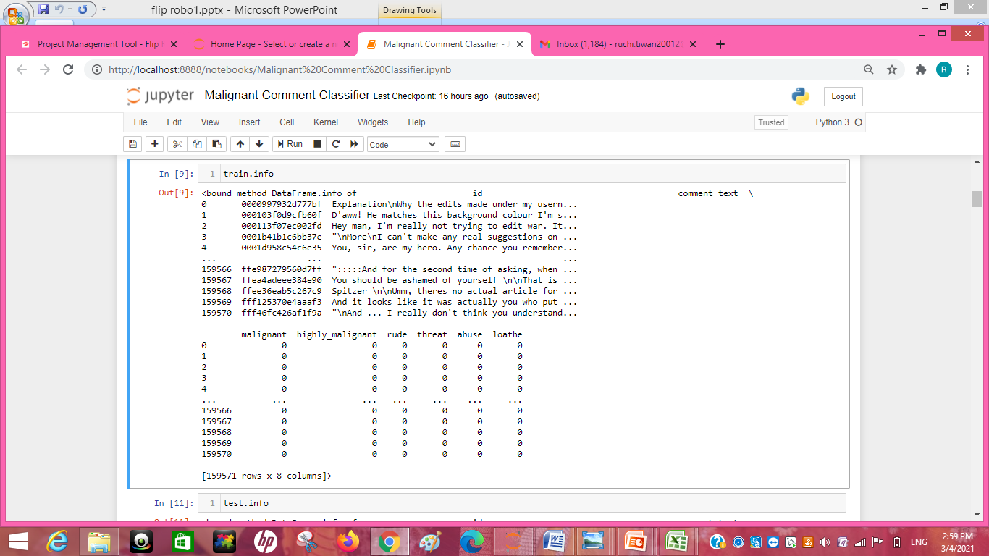
About Data:- With the help of info I get to know that their the data types of each columns.

Slide 6
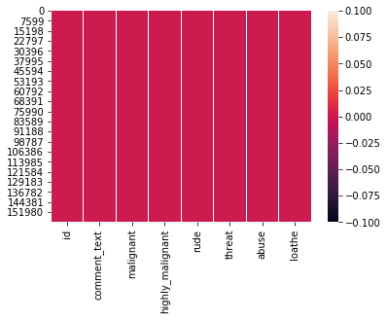
There is no null values present in the dataset we can see it.

Slide 7
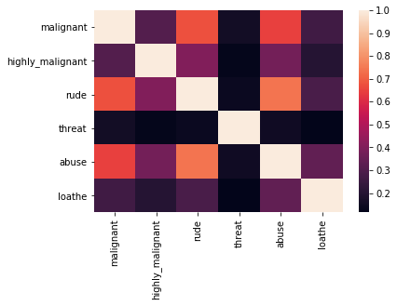
Correlation of the features

Slide 8
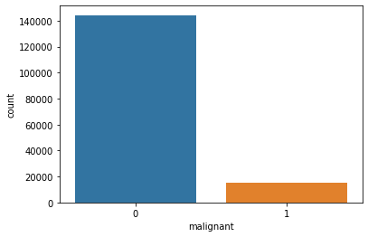
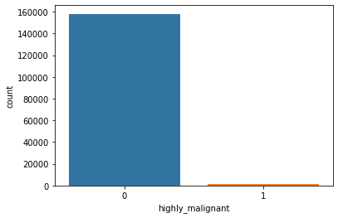

Slide 9
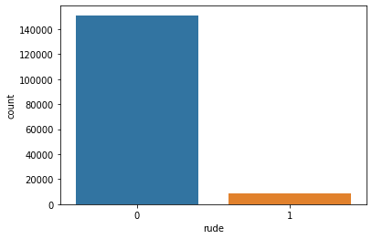
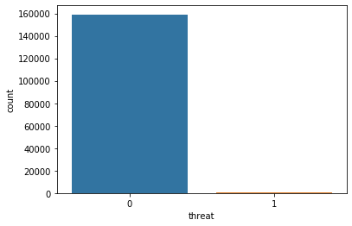

Slide 10
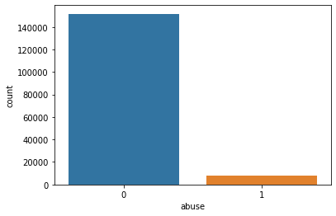


Slide 11
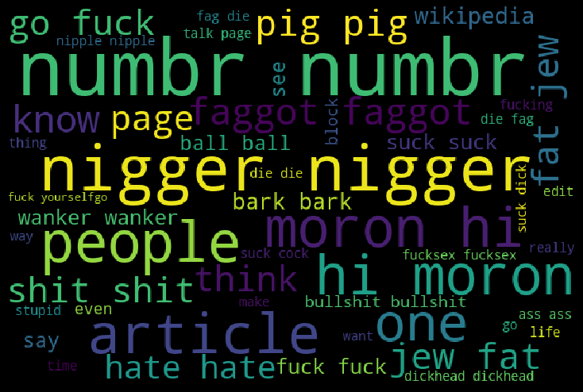
Loud Words In the Dataset

Slide 12
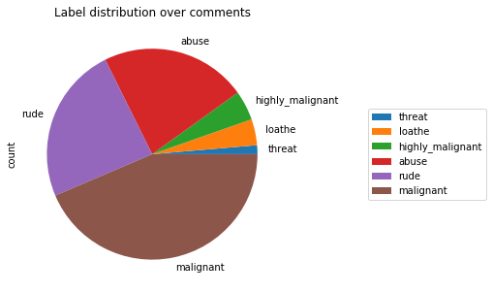
Distribution of comments

Slide 13
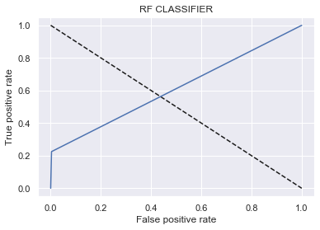
False positive rate and True positive rate

Slide 14
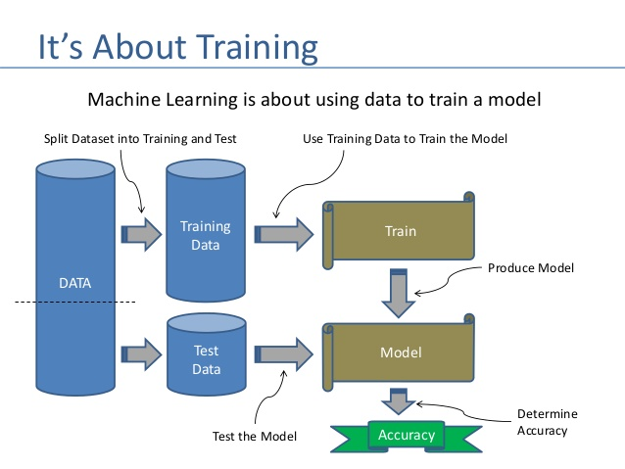

Slide 15
Importing Library to apply algorithms
from sklearn.naive_bayes import MultinomialNB
from sklearn.model_selection import train_test_split
from sklearn.metrics import accuracy_score, confusion_matrix, classification_report,roc_curve,roc_auc_score,auc
from sklearn.model_selection import train_test_split
from sklearn.metrics import accuracy_score,classification_report,confusion_matrix,f1_score
from sklearn.linear_model import LogisticRegression
from sklearn.model_selection import cross_val_score,GridSearchCV
from sklearn.naive_bayes import MultinomialNB
from sklearn.tree import DecisionTreeClassifier
from sklearn.neighbors import KNeighborsClassifier
from sklearn.ensemble import RandomForestClassifier,AdaBoostClassifier,GradientBoostingClassifier
from sklearn.naive_bayes import GaussianNB
from sklearn.linear_model import LogisticRegression
from sklearn.svm import SVC
from sklearn.tree import DecisionTreeClassifier

Slide 16
Results
LogisticRegression
Training accuracy is 0.9595609629450577
Test accuracy is 0.9553392379679144
DecisionTreeClassifier
Training accuracy is 0.9988898736783678
Test accuracy is 0.9394635695187166
RandomForestClassifier
Training accuracy is 0.9988719684151156
Test accuracy is 0.9547125668449198
AdaBoostClassifier
Training accuracy is 0.951118631321677
Test accuracy is 0.9490307486631016
KneighborsClassifier
Training accuracy is 0.922300110117369
Test accuracy is 0.9173629679144385

Slide 17
CONCLUSION
I check the data first and uploaded the data in jupyter notebook and than I visualize the features ,Perform the preprocessing in the data and understand the relationship between different features.
I used both train-validation split and the cross validation to evaluate the model effectiveness to predict the target values.
At the end I applied the 5 models in the dataset.
I started with the LinearRegression, DecisionTreeClassifier, RandomForestClassifier,
KNeighboursClassifier, adaboostClassifier
Based on the best result I saved to model RandomForestClassifier.

